Slide 1
Learning & Development Enabling development, Impacting growth…
RDV-03
QlikView Training – Day 3

Slide 2
RECAP
Comments in QlikView
Transformative Functions – AS, ALIAS and QUALIFY
CONCATENATION
JOIN
KEEP
Mapping Tables

Slide 3
Session Agenda – Day 3
Introduction to Charts
Data Visualization.qvw
Various Charts
Bar Chart
Line Chart
Combo Chart
Gauge Chart
Tabular Charts
Visual Cues
Mini Chart
Trellis

Slide 4
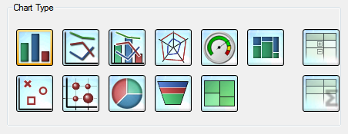
Introduction to Charts
Primary Component of any QlikView Dashboard
13 In-built Chart Types available – Each Chart with one or many Styles (variations)
Additional Charts are also available through Extensions
Very Easy to configure through various sets of Properties
Selections can made by selecting the UI (in most of the charts)

Slide 5
Introduction to Charts (contd)
Properties of any Chart will have the following Tabs. There might be additional tabs, which are specific to the type of the Chart
General Tab
Dimension Tab
Expressions Tab
Sort Tab
Style Tab
Presentation Tab
Colors Tab
Number Tab
Font Tab
Layout Tab
Caption Tab

Slide 6
Data Visualization.qvw
Available in Examples Folder
Helps you choose “When to use which chart” by mapping Charts to use cases
Suggests the best practices to be followed in choosing a chart
Showcases QlikView’s visualization capabilities

Slide 7
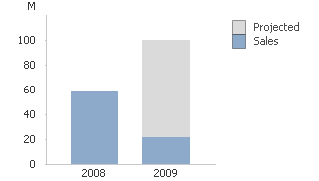
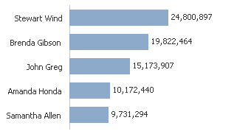
Bar Chart
Good for Comparisons of Similar Measurements
Implies that Data is Discrete
Limit the Number of Bars / Use Scroll Bar
Common diagram style, easy to understand

Slide 8
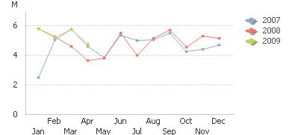
Line Chart
To compare movements over time, line charts can be used.
They show each data point's movements by connecting with lines which let you follow their behaviors easily.

Slide 9
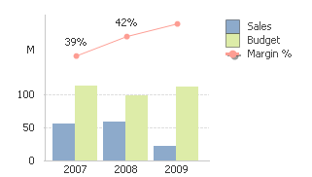
Combo Chart
Comparisons for Multi-Measurements

Slide 10
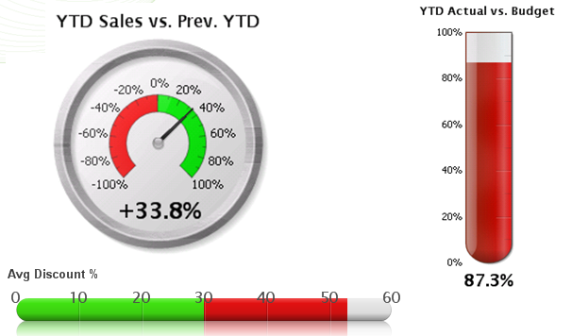
Gauge Chart
Ratio of Measurements

Slide 11
Q & A
QlikView Training – Day 03

Slide 12
Lab Work
Create a QlikView Dashboard to showcase the following KPIs with the help of the shared Data Sets (Orders, Order Details, Product, Product Category and Customers)
Add Filters Products, Product Category, Customer Country and City
Overall Freight Percentage. Use the following range of scale – Green < 5%, Amber > 5% < 10%, Red > 10%.
Number of Products available under each Category
Sales Trend Information
A Chart to depict the number of customers who bought something and the amount of sales they have made.

Slide 13
Tabular Charts
Simplest Way to Present Data
Table Box – Used to Display Multi-Dimensional Data WITHOUT involving any Calculations
Straight Table – Is a Table Box Supporting to Calculations. Usually, there will one dimension (with an Optional Cyclic / Drill-Down Capability) and multiple expressions.
Pivot Table – Often used with Multiple Dimensions, and when Grouping of dimensions is required (with optional sub-totals). Resource Intensive – impacts performance.
Do not have too many table charts in your app – QlikView is meant for analytics and NOT reporting.

Slide 14
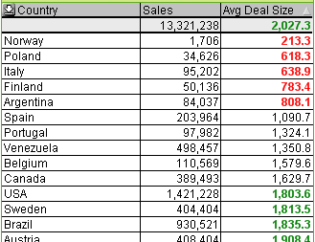
Visual Cues
Used for highlighting expression values with respect to different formats (Font Style / Color and/or Cell Color)
Available only for Straight / Pivot Tables.
Values belonging to different intervals are typically given different cues

Slide 15
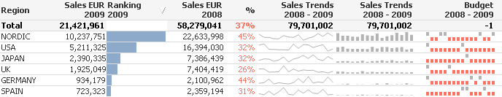
Mini Chart
Multi-dimensional snapshots and comparisons
Graphical Charts show more than numbers while Tabular Charts show the exact actual figures – With Minicharts, there is no need to pick one or the other. Minicharts takes tables to the next level.

Slide 16
Mini Chart (contd)
There are various modes for minicharts. Use,
Line to show movements,
Bars to show the quantitative values
Wiskers to show the win/loss values.
There are representations other than minicharts as well – Gauges – used to represent Ratios / States (like Red, Amber and Green, etc)

Slide 17
Trellis Chart
Grid of Small Charts
Repetition of a Chart with respect to the first dimension and the actual chart with second dimension
Typically used for comparison of groups at one point of time.

Slide 18
Q & A
QlikView Training – Day 03

Slide 19
Lab Work
Use the Application created in the previous session and perform the following
Show the Names of the Customers and location details (City and Country)
Show the Names of the Customers and Sales made by them (show only top 10)
Show Sales Information with respect to Customer Country, City with sub-totals for country. Add a Time Dimension to the same chart.
A chart to show Product Category, Freight Cost, Sales, Average Freight %. Use Color Codes to indicate Discount Numbers – Green < 5%, Amber > 5% < 10%, Red > 10%. Include an additional column to show the same information using Graphical Icons)

Slide 20
Thank You
Review Date | 28-Aug-2015
Version | 1.0
Next Review Due | 28-Aug-2016

